Slide 1
Environmental Conservation Alternative Break Groton, Connecticut Weekend Program Info Session Student Program Director: Tanvir Siddique
USG Storrs funding supports Alternative Breaks

Slide 2
Agenda
INTRODUCTION 3
WHAT IS CO? 4
WHAT IS ALT BREAK? 5
THE PROGRAM 6
COMMUNITY PARTNERS 7
LOGISTICS 8
SAMPLE DAY 9
OTHER COMPONENTS 10

Slide 3
About Me Name: Tanvir School Year: Junior Major: Political Science

Slide 4
WHAT IS CO? Community Outreach (CO) at the University of Connecticut is dedicated to enriching the educational experience by empowering students to become active global citizens. Through service activities, CO fosters a commitment to social responsibility, encouraging students to engage in initiatives that not only benefit others but also contribute to their own personal growth. By participating in CO programs, students enhance the quality of life within communities while developing skills and values that will guide them in their future endeavors as leaders and advocates for change.

Slide 5
What is Alternative Break? Alternative Breaks are service-learning experiences that work with communities to build a more equitable and inclusive society. These programs are designed to raise participants' awareness of important social issues, support their personal growth, and prepare them for a lifetime of social action. Each weekend or week-long trip combines service, reflection, and education, focusing on key social justice topics like racial justice, environmental justice, and healthcare. Through these experiences, participants contribute to positive change while gaining valuable skills and insights.

Slide 6
Environmental Conservation Program
The Environmental Conservation program offers a weekend-long immersive experience where we come together to address pressing environmental issues.
Throughout the program, we engage in hands-on activities such as beach clean-ups, removing invasive species, and caring for native ecosystems. By the end of the weekend, we gain a deeper understanding of ecosystems, environmental challenges, and sustainable practices that we can apply within our own communities.

Slide 7
Community Partners
Throughout the program, we will actively collaborate with various community partners who will play an essential role in helping us engage meaningfully with the community. These partners provide invaluable insights and expertise, enriching the learning experience for participants and fostering personal growth throughout their service work. We also have strong housing partnerships that ensure accommodation is provided during our weekend programs, further enhancing the support network.
In addition, UConn staff members are readily available to offer resources and risk management support, while also overseeing the financial aspects of the program to ensure its smooth operation.
Carl Soares, our dedicated staff program coordinator, works closely with students to ensure the successful execution of alternative break initiatives, guiding the process from start to finish.
We extend our special thanks to the Undergraduate Student Government (USG) for their crucial financial support, which makes these programs more accessible and affordable for Storrs undergraduate students.

Slide 8
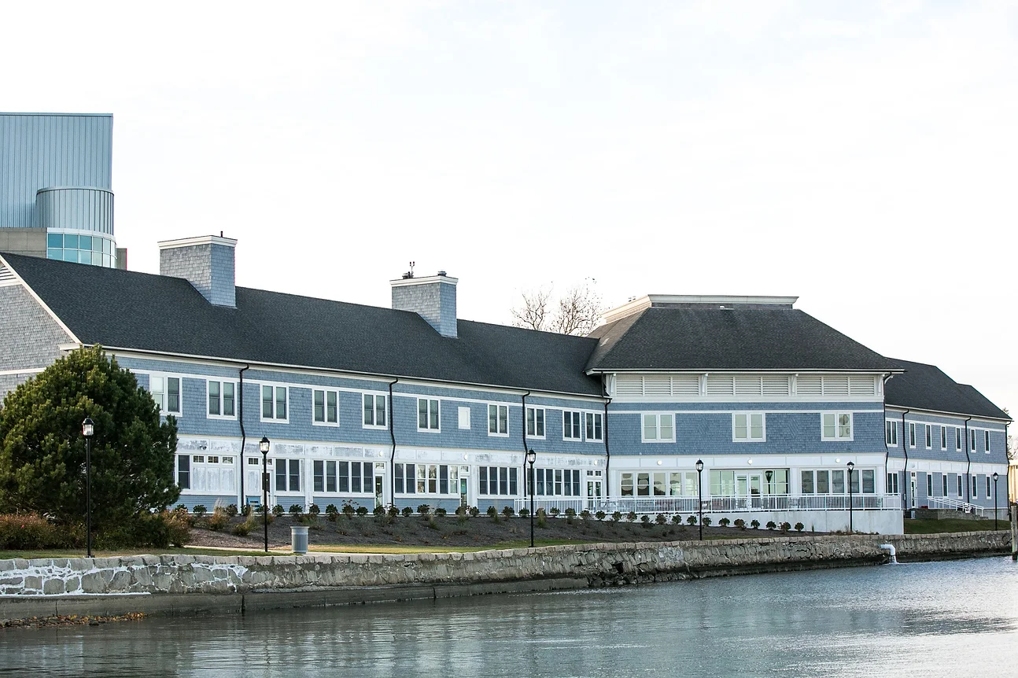
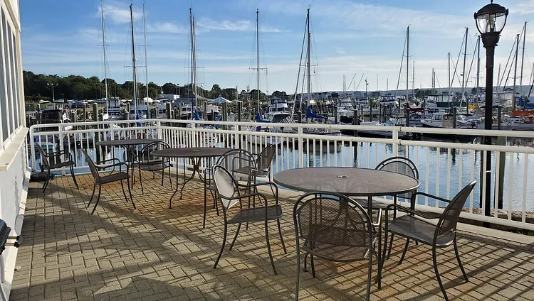
Logistics
Date: April 11- April 13, 2025
Size: 18 participants, 1 student program director, 1 staff
Participant cost: $25
Transportation: We will be traveling to the location via UConn-provided transportation. Vehicles will be supplied by UConn, and participants who meet specific eligibility criteria will be encouraged to volunteer as drivers to support the team.
Housing: We will be staying at Project Oceanology, where their spacious 56-bunk hostel provides comfortable accommodations for all volunteers, complete with stunning ocean views. In addition to the cozy lodging, we’ll have access to a large dining room, ensuring we have a convenient and welcoming space to enjoy meals together throughout our stay. All meals will be covered during the trip.

Slide 9
Sample Schedule (Service Day)
8 am - Breakfast
9 am - leave project o
9:30 to 11:30 am - Work on invasive species removal
12:00 to 1 pm - lunch
1 to 4 pm – bluff point beach cleanup
4:30 pm – return to project o
4:30 to 6 pm – free time
6 pm- dinner
7pm – reflection
8 to 10 pm – free time
10 pm – sleep
*This schedule is a sample and may be subject to change.

Slide 10
OTHER COMPONENTS
Pre-Alt Break Meetings: Participants will attend 4-5 pre-program meetings, providing an opportunity to connect with each other, gain a deeper understanding of the program's objectives, and adequately prepare for the upcoming service activities. These meetings are mandatory as we will go over materials that are important for safety, preparation, and learning about expectations.
Re-Orientation: Following the program, all participants will be invited to take part in a dedicated service day. This event offers a valuable opportunity to reconnect with fellow participants, apply the skills and knowledge gained during the program, and demonstrate an ongoing commitment to community service.

Slide 11
thank you
If you have any further questions about the program, please reach out to me at Uconn.co.groton@gmail.com

